Slide 1

IMPACT ASSESSMENT OF COVID19 ON BUSINESS ACTIVITY IN ALBANIA
This survey is based on the first survey conducted by the Secretariat during April 2020 and aims to collect data for the period of 12 months (April 2020 - April 2021)
Tirana, June 2021

Slide 2

METHODOLOGY
Companies
Context
Problem
417 companies responded to an online questionnaire with 30 closed and opened questions
The chosen method is the Simple Random Method. The survey was distributed via email sent to 10,000 companies.
Data were collected anonymously and randomly. The survey includes data from April 19 - May 5, 2020
The survey “Assessment of the impact of the COVID-19 pandemic on business in Albania”, an initiative of the Secretariat of the Investment Council and the Ministry of Finance and Economy, was undertaken in April-May 2020 with the aim of gathering evidence on the effects of the COVID-19 pandemic on its business and activity.
After 1 year, the Secretariat undertook a similar survey (70% are same questions) to assess the business challenges and real effects of the COVID-19 pandemic.
COVID-19 impact on:
Economic growth
Work force
Innovation

Slide 3
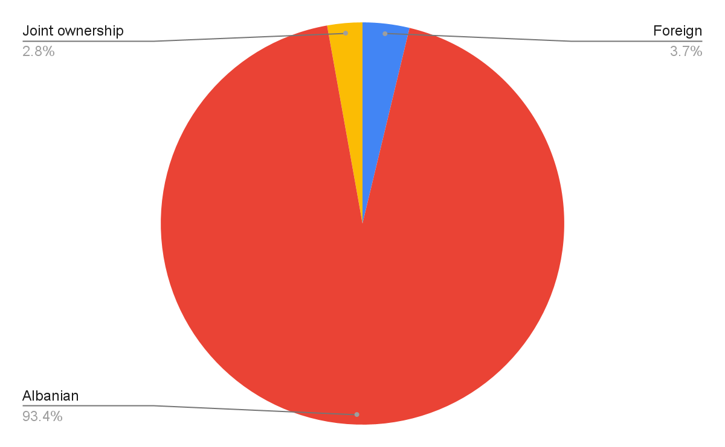
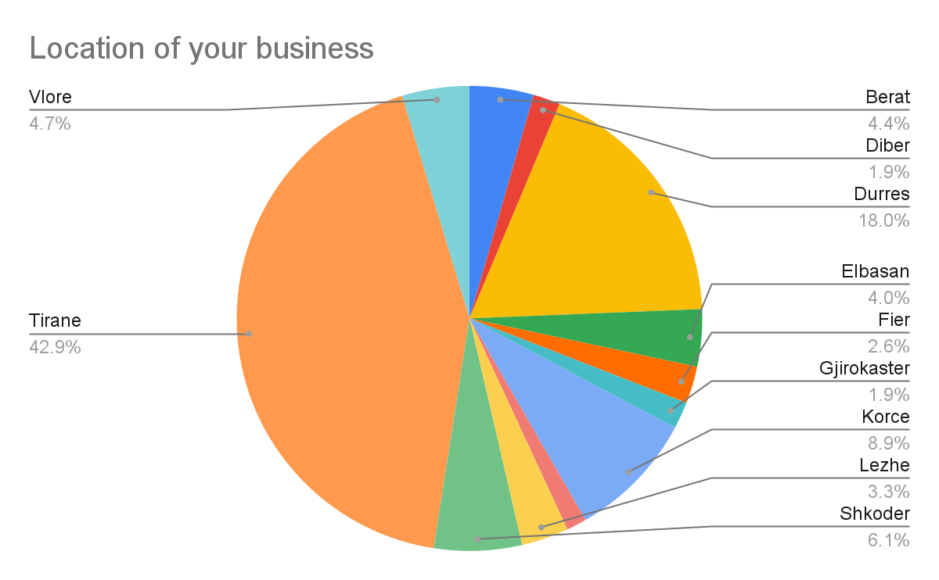
Sample Profile
Challenge 2
The sample includes companies from every region of the country, mainly Albanian-owned companies

Slide 4
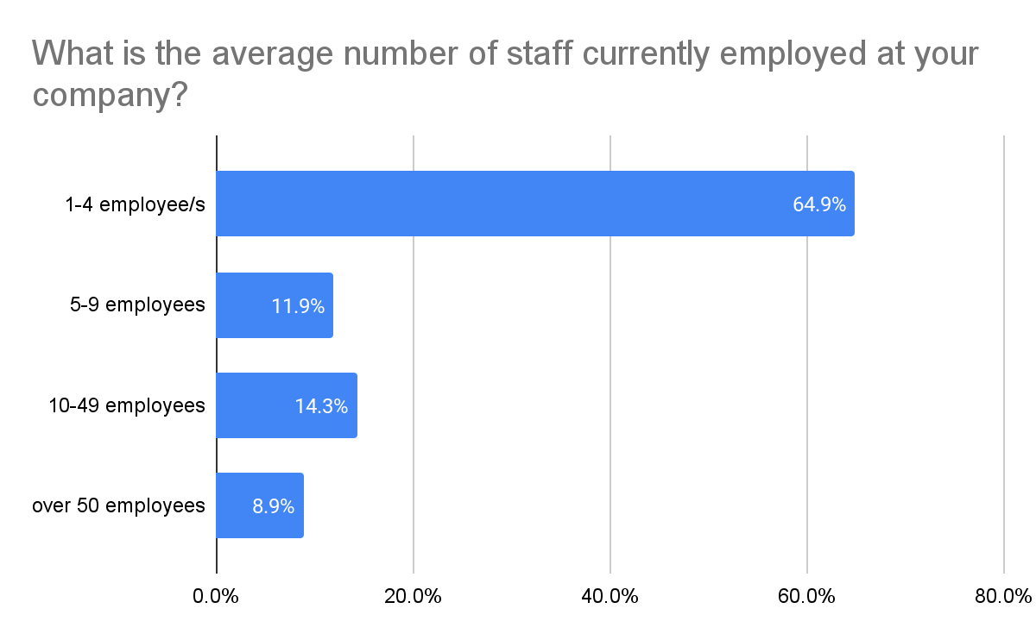
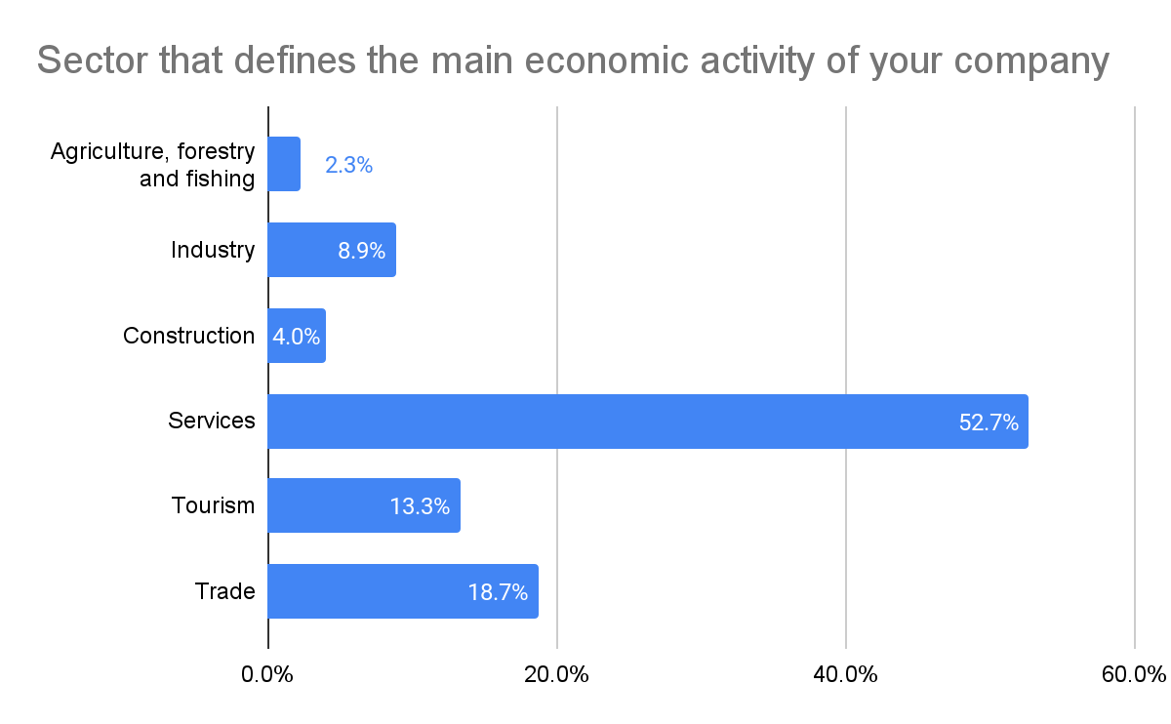
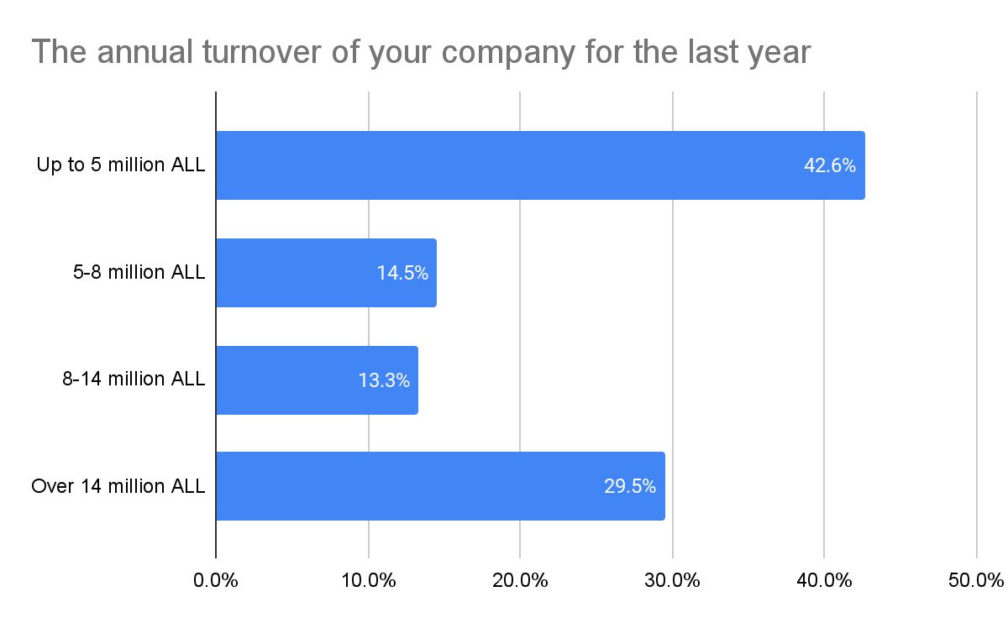
Sample Profile

Slide 5
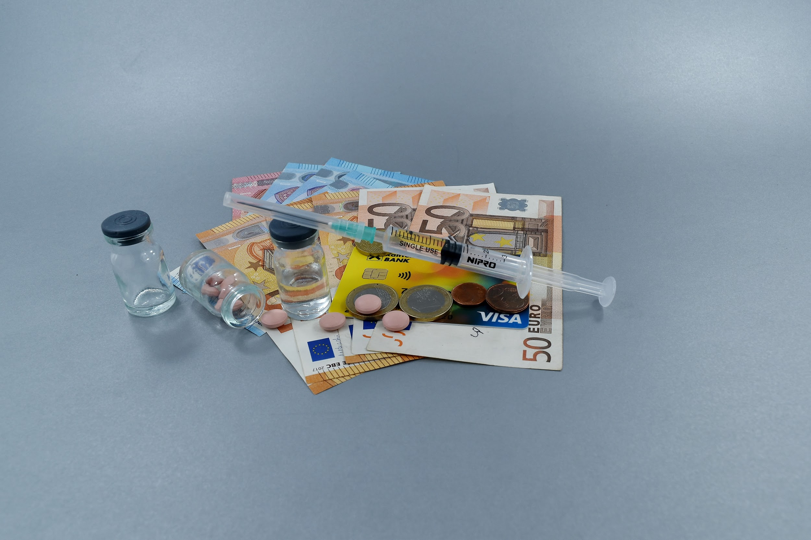
Economic Growth and COVID-19
The effects of COVID-19 and expectations for the future

Slide 6
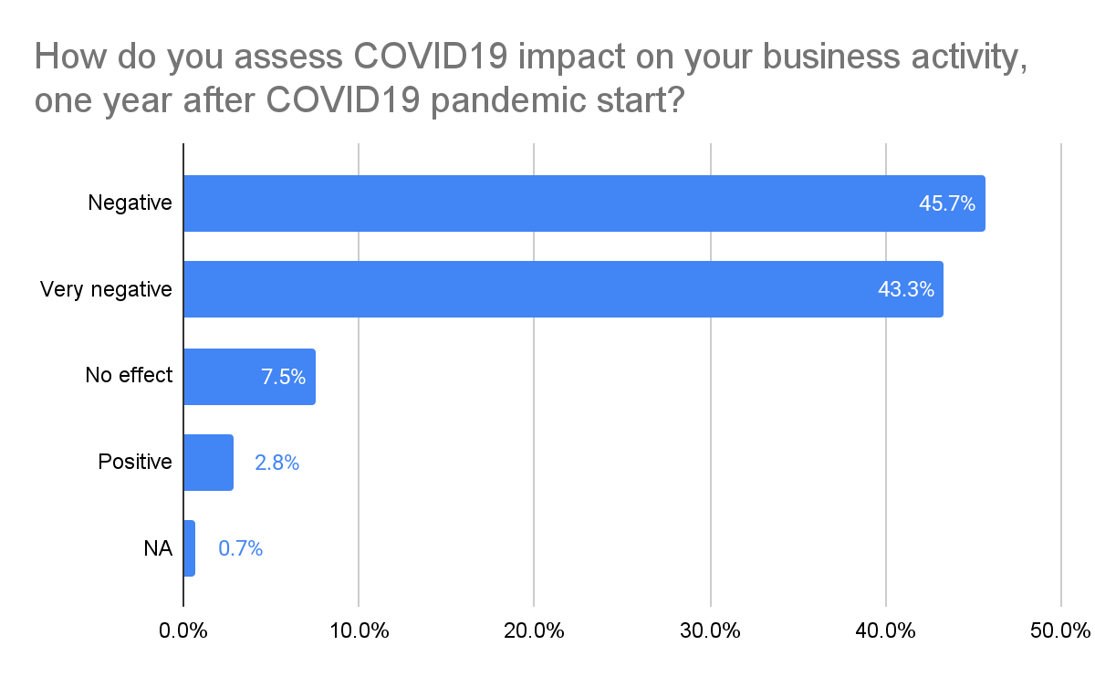
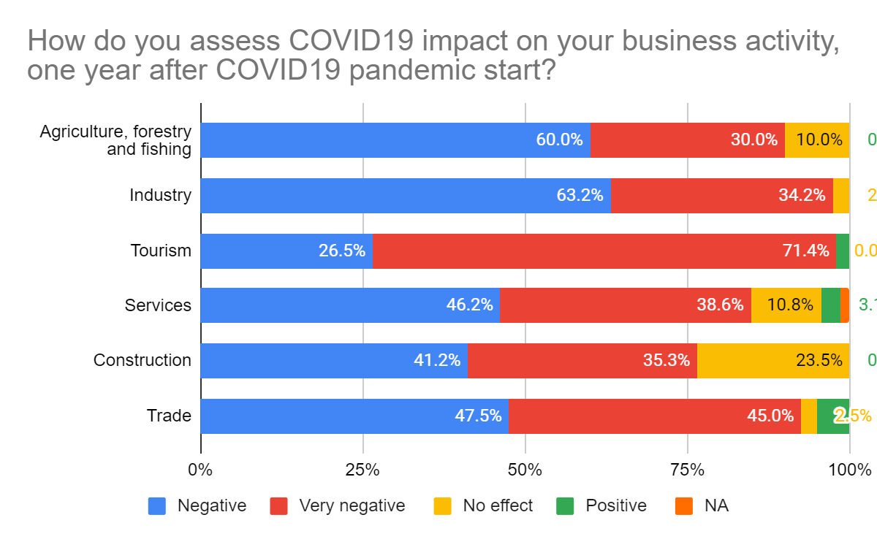
How do you assess COVID19 impact on your business activity, one year after COVID19 pandemic start?
All sectors assessed a negative impact which is confirmed by the data of 1 year later;
Tourism, Industry and Trade are the most affected sectors by the COVID-19 pandemic; Construction and Agriculture are the sectors least affected by the pandemic
98% of exporters declared the negative/very negative effect (32% considered it as very negative)
During April 2020, 97% of respondents estimated that COVID-19 would have a negative / very negative impact;
One year later, 89% of companies confirm the negative / very negative effect of the pandemic on their activity
Challenge 2
Notes:
Te dhenat e INSTAT ne lidhje me vleresimin per rritjen ekonomike per tu perfshire ne brief; kontributi sipas degeve te ekonomise;

Slide 7
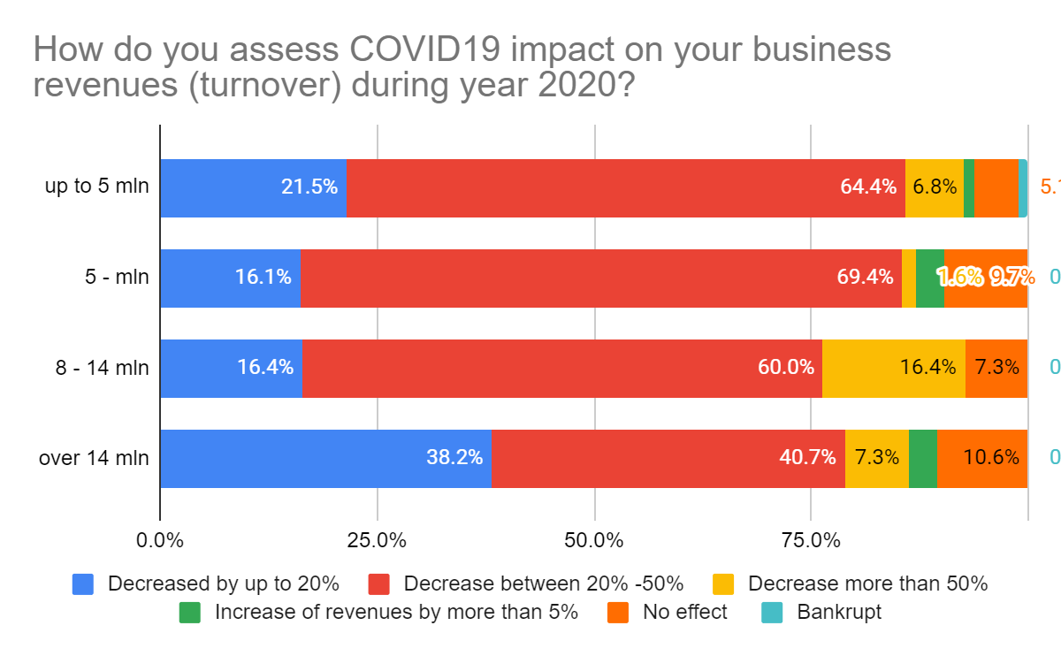
How do you assess COVID19 impact on your business activity, one year after COVID19 pandemic start?
Despite the size over 80% of companies estimate the negative / very negative impact of the COVID-19 pandemic
The most negative impact of the Pandemic is estimated in companies up to 5 million ALL annual turnover and with 8 - 14 million ALL annual turnover
Challenge 2
Notes:
Te dhenat e INSTAT ne lidhje me vleresimin per rritjen ekonomike per tu perfshire ne brief; kontributi sipas degeve te ekonomise;

Slide 8
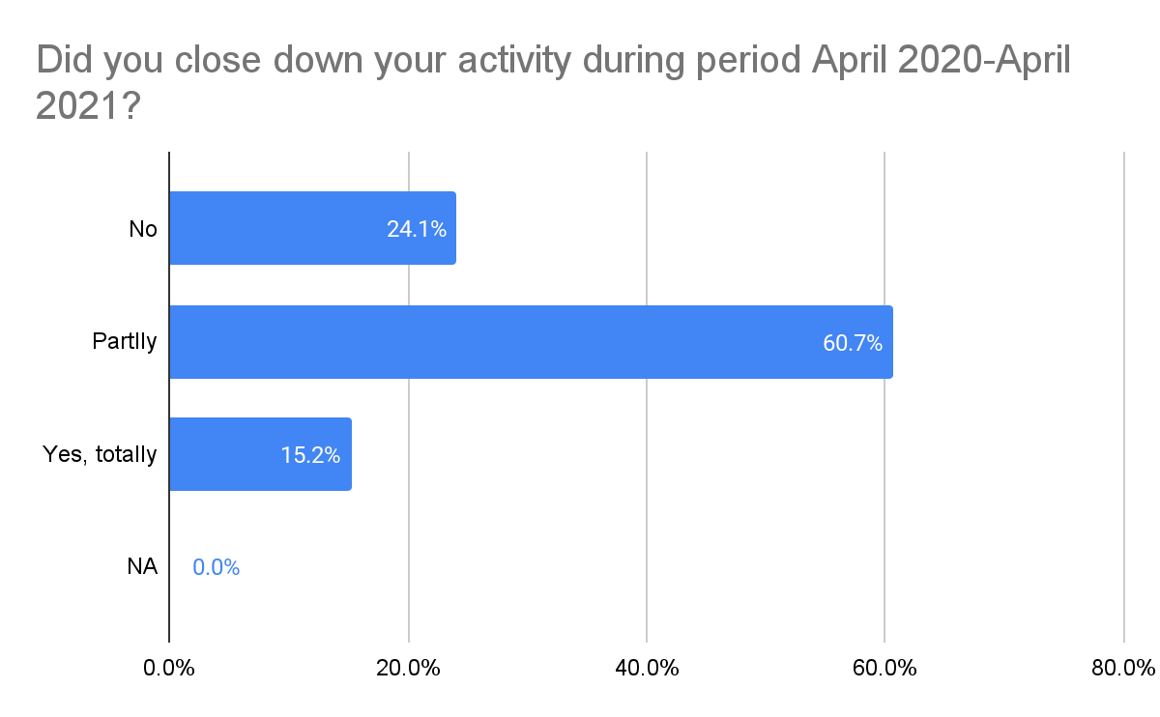
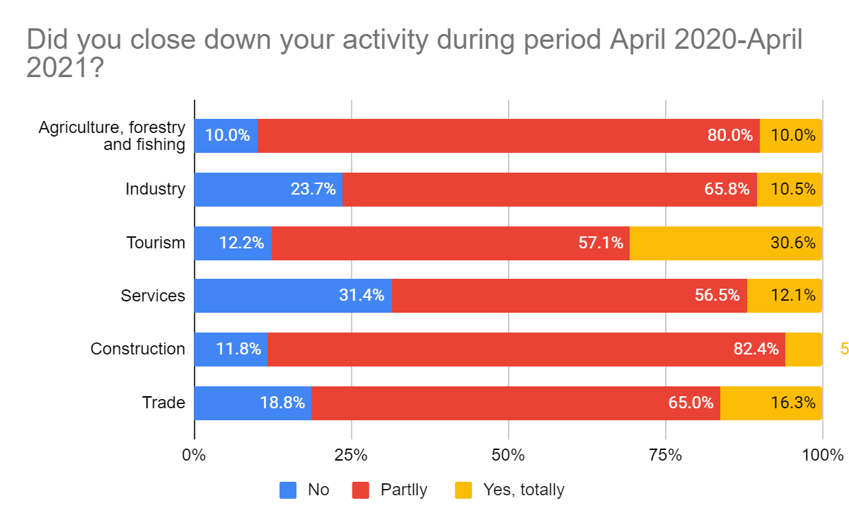
Did you close down your activity during period April 2020 - April 2021?
75% of surveyed companies continued to operate partially / totally during the pandemic;
88% of companies stated that the closure lasted up to 6 months; only 12% of companies declared a closure of over 6 months mainly in Tourism
In the highest percentage, companies operating in the Tourism sector are those that declare the total closure of the activity;
while Services, Industry and Trade have the highest percentage in terms of non-interruption of activity

Slide 9
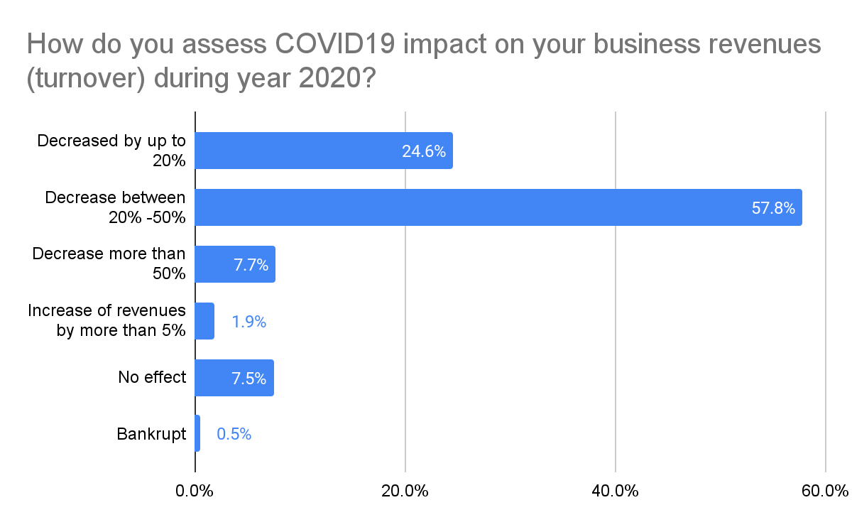
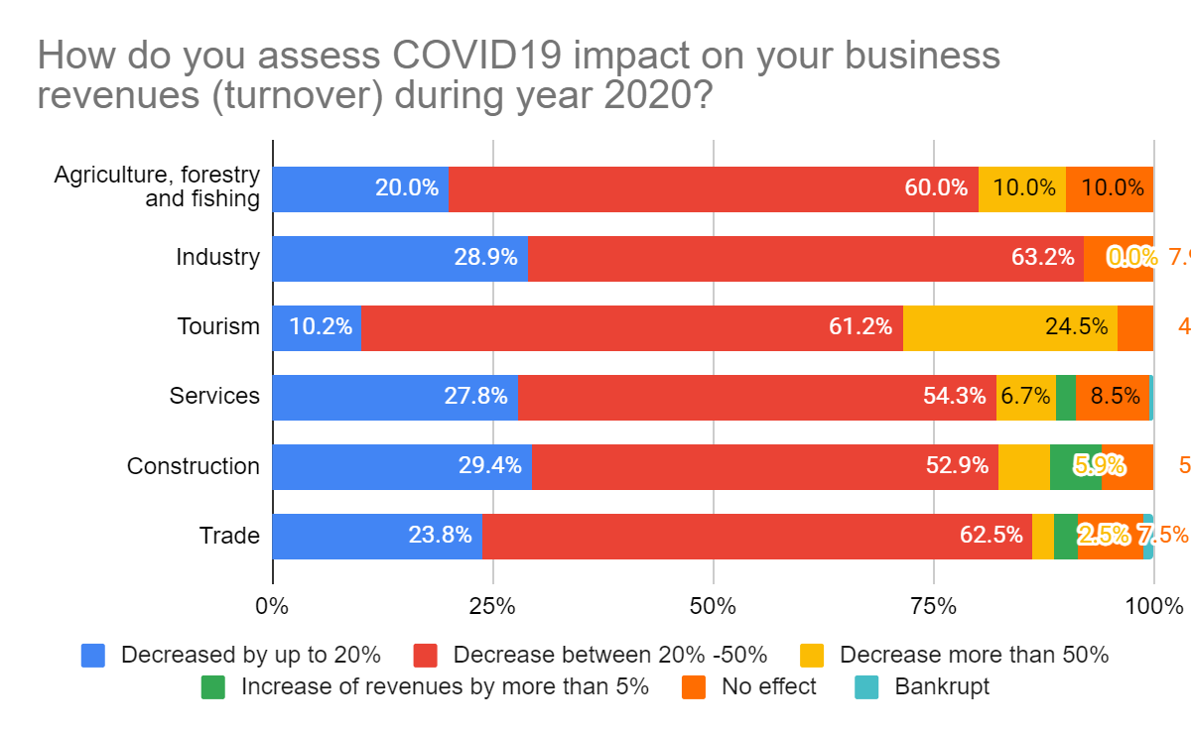
How do you assess COVID19 impact on your business turnover during 2020?
80% of respondents on April 2020 expected a reduction of more than 20% of annual income and only 3% of them thought that COVID19 would not affect their annual income
1 year later, 65% of respondents stated a decrease of more than 20% in activity and 8% of them stated that COVID-19 did not affect them; Meanwhile 1.9% of companies experienced an increase of more than 5%
Tourism, Industry and Agriculture declare the biggest loss
Challenge 2

Slide 10
How do you assess COVID19 impact on your business turnover during 2020?
In the largest percentage companies estimate a reduction in their revenues from 20% to 50% during 2020
Challenge 2

Slide 11
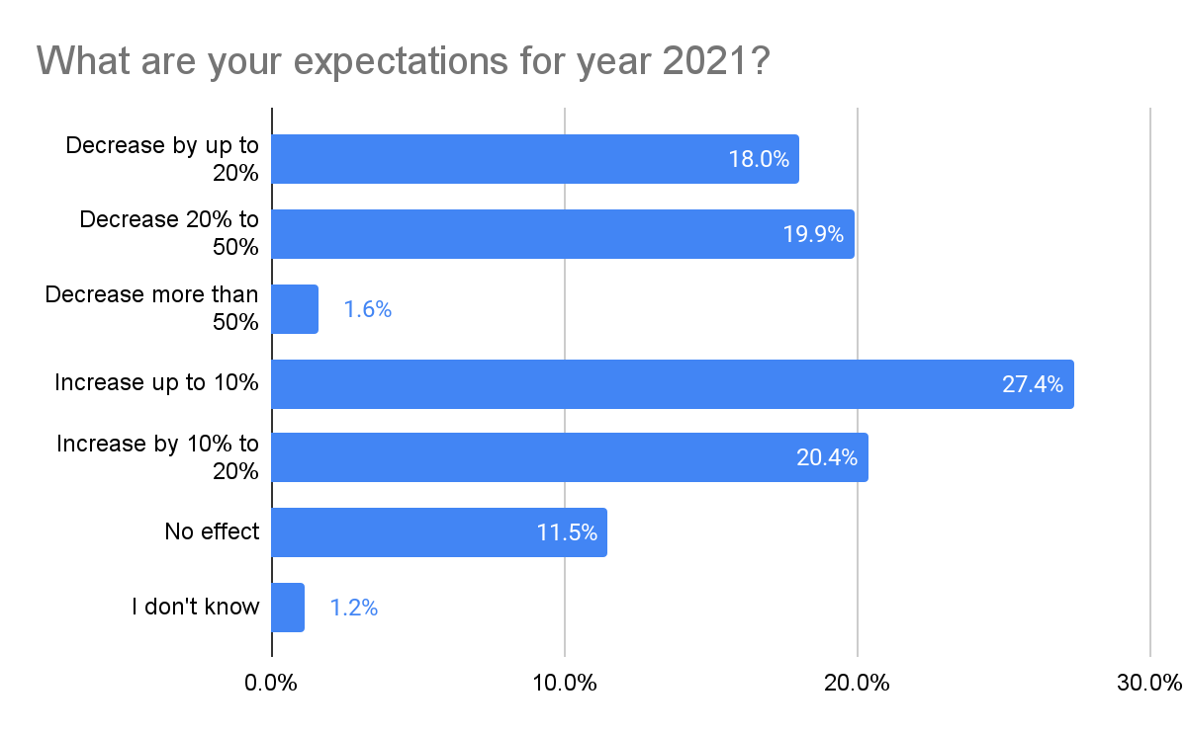
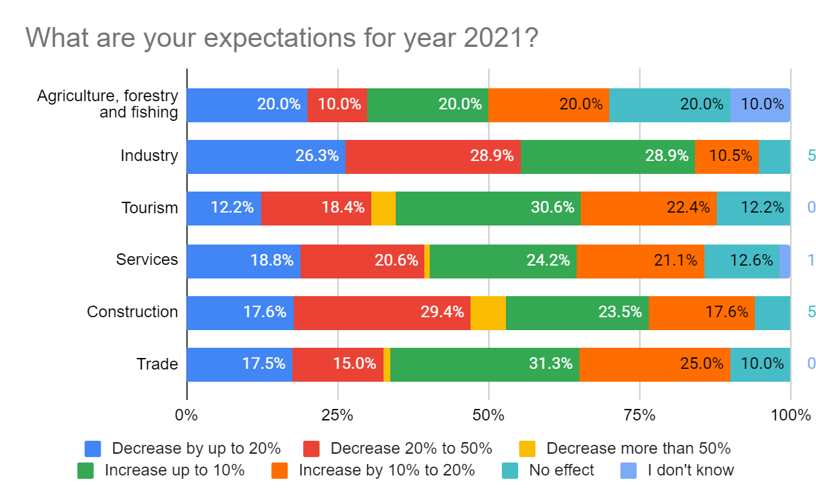
What are your expectations for 2021?
40% of respondents expect a decline in their income during 2021, mainly in the sectors of Industry, Construction and Services
47.5% of respondents expect an increase in their income during 2021, mainly in the Tourism and Trade sector
Challenge 2

Slide 12
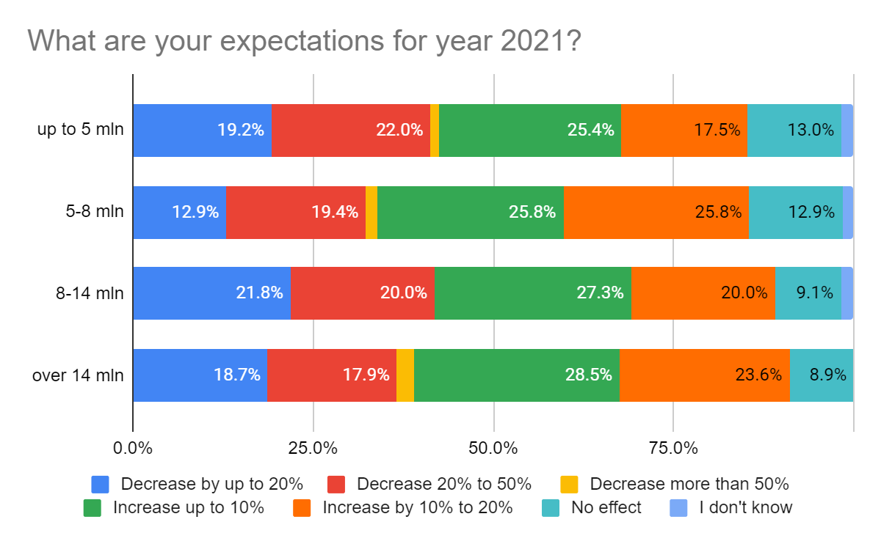
What are your expectations for 2021?
Companies up to 5 million estimate a reduction of up to 50% in 41% of them, while about 43% of them expect an increase of up to 20%
For companies 5 - 8 mln, about 32% of them expect a reduction of up to 50% and 52% expect an increase of up to 20%
Companies estimate 8-14 million annual turnovers in 42% of them decrease up to 50%, while 47% of them increase up to 20%
Companies with a turnover of over 14 million estimate in 37% of them a reduction of up to 50%, while 52% of them expect an increase of up to 20% during 2021
Challenge 2
Notes:
Vendosim pritshmërite e qeverisë për rritjen ekonomike

Slide 13
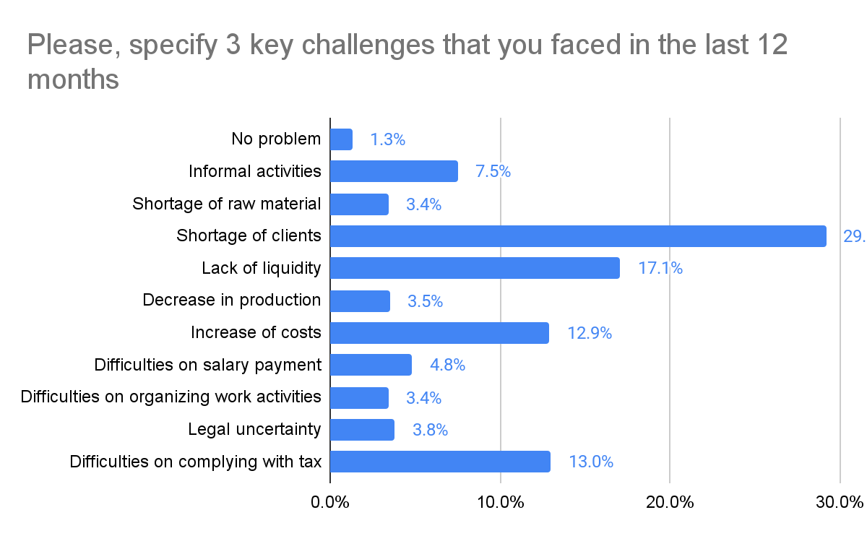
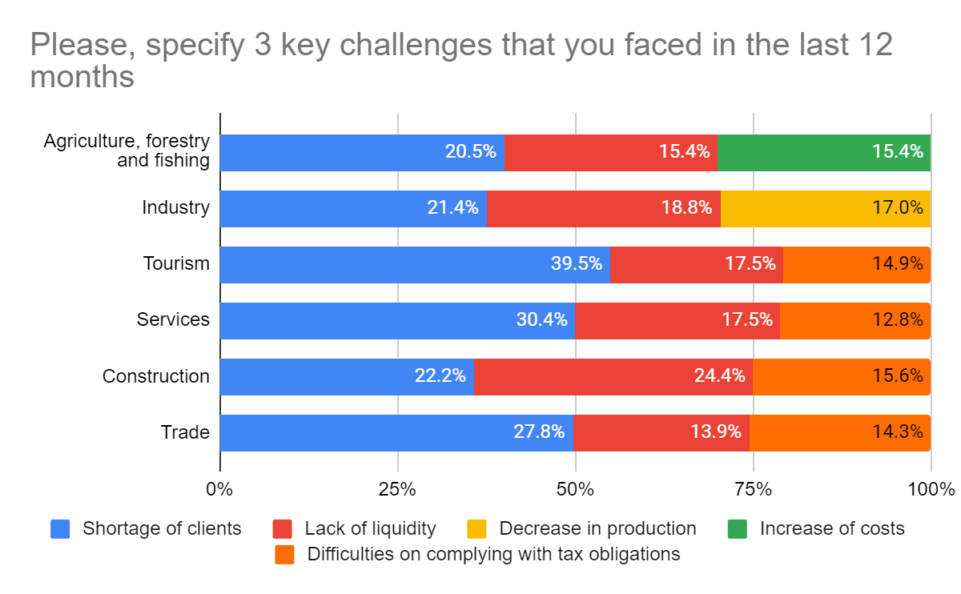
Please, specify 3 key challenges that you faced in the last 12 months
If we compare answers on the main problems encountered by the business, we see that the lack of customers and the lack of liquidity continue to be at the top; while 1 year ago companies were concerned about the inability to pay salaries, after a year this has been replaced by the inability to pay taxes; the picture is more or less the same between different sectors of the economy
"Wage subsidy" has addressed business concerns about the inability to pay wages
Challenge 2

Slide 14
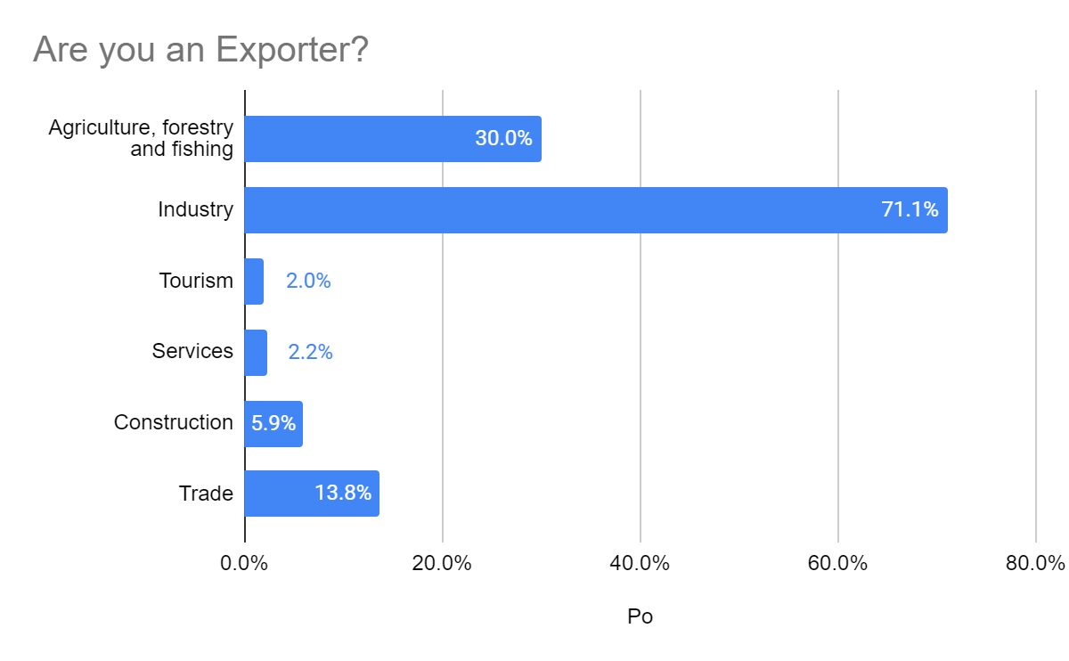
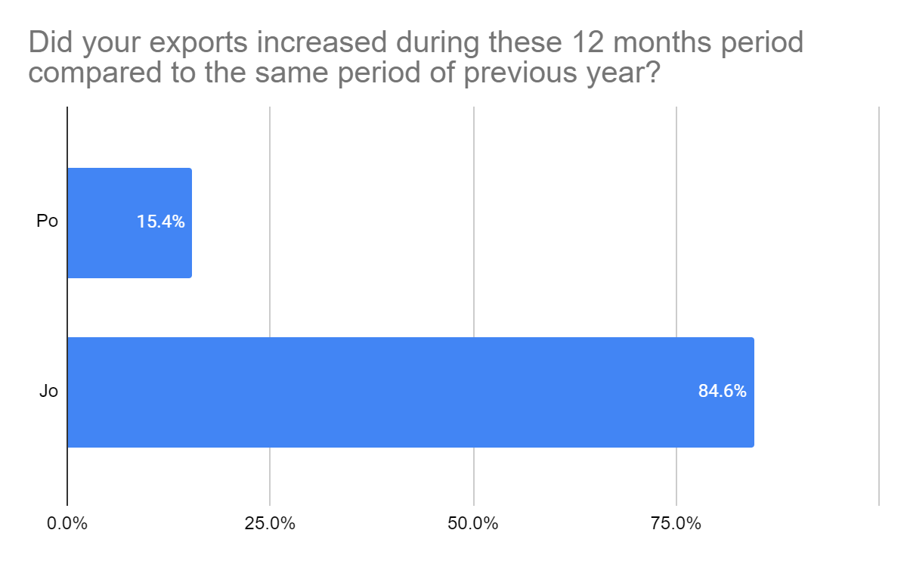
Do you Export?
12% of respondents are exporters, mainly Industry, especially Manufacturing and Agriculture
85% of exporters declare a decrease in their exports in the last 12 months
Notes:
INSTAT deklaron rritje 7,7% te eksporteve

Slide 15
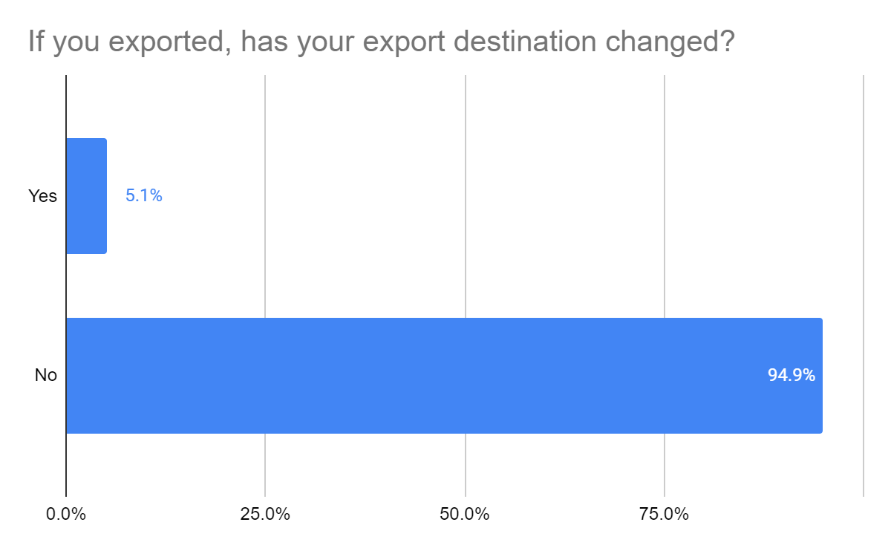
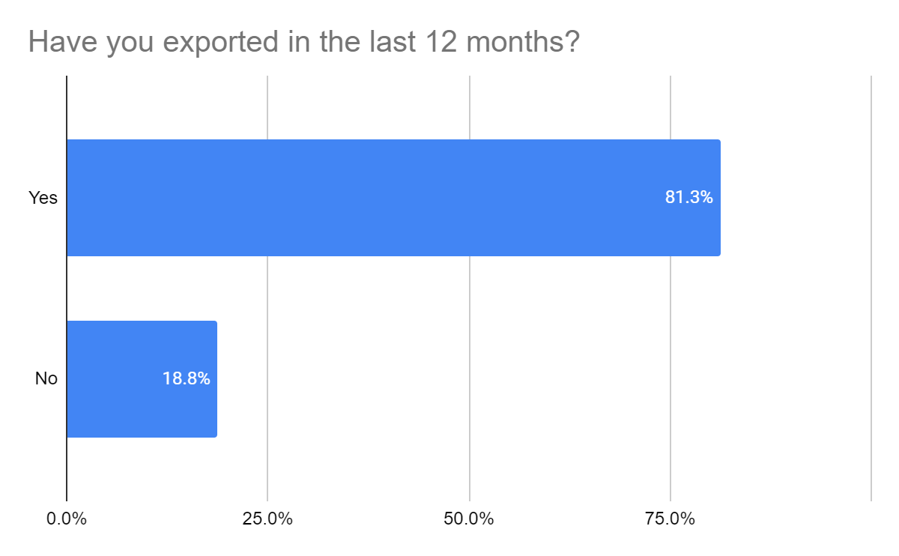
Do you export?
81.3% of exporters have continued their activity during the last 12 months;
Despite the pandemic the exporters have not changed their export destinations

Slide 16
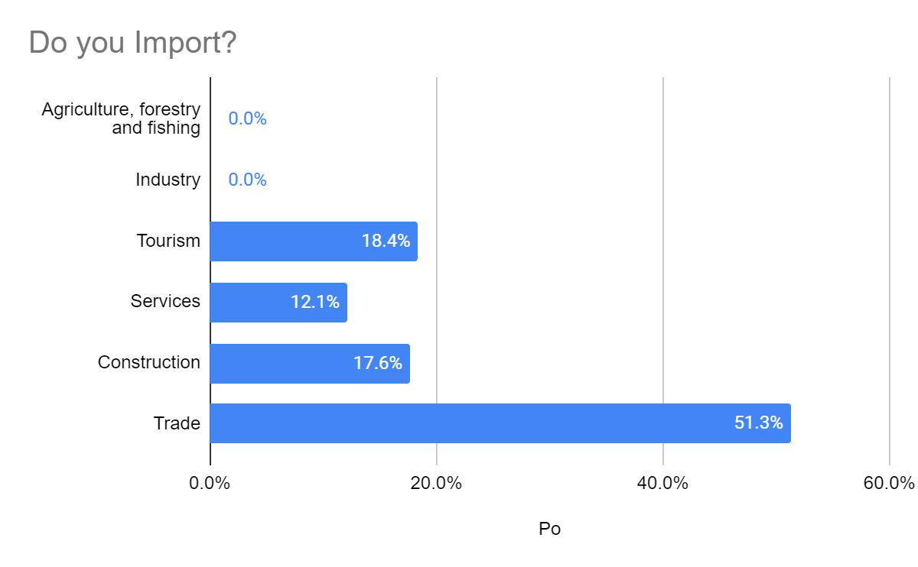
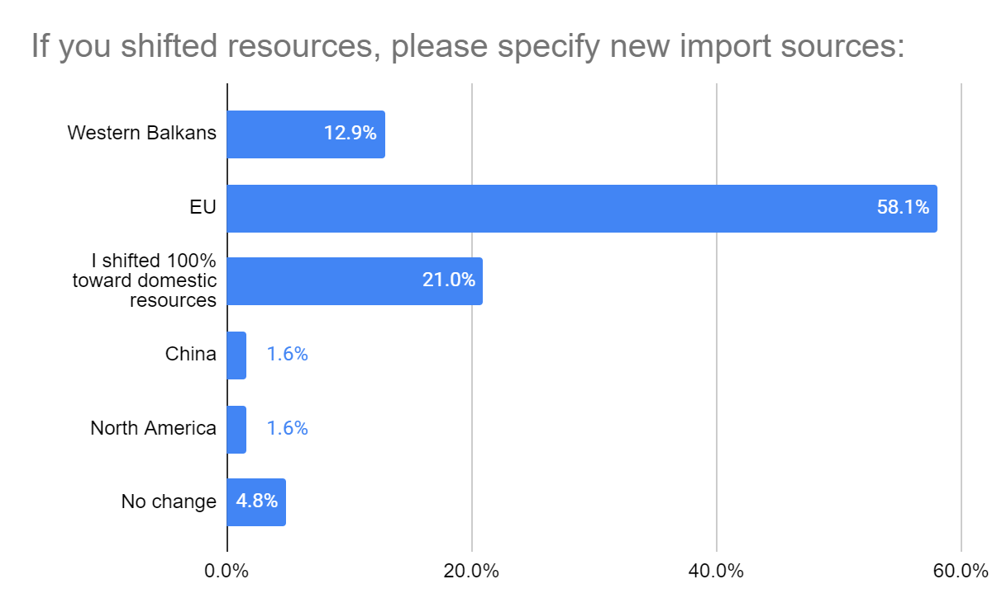
Do you import?
25% of respondents import from different countries of the world, mainly in Trade, Tourism and Construction
57% of respondents stated that they have changed import countries, focusing mainly on the EU and WB;
and 21% of them state that they have replaced imports with domestic products, mainly in Services and Trade
Challenge 2

Slide 17
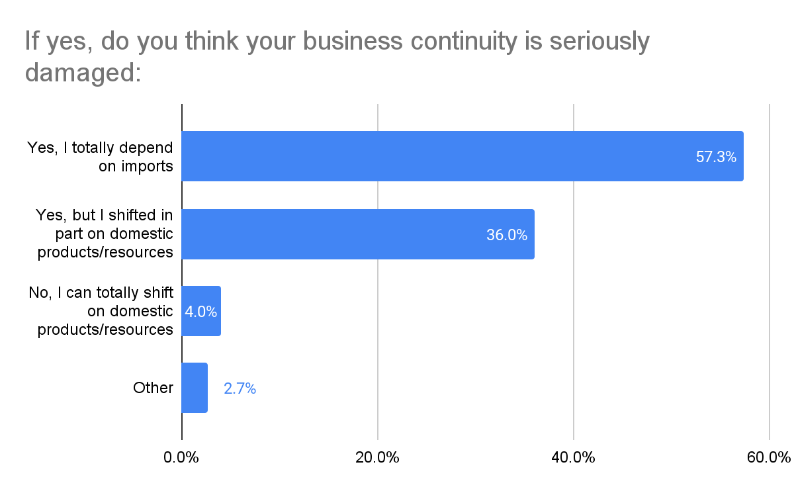
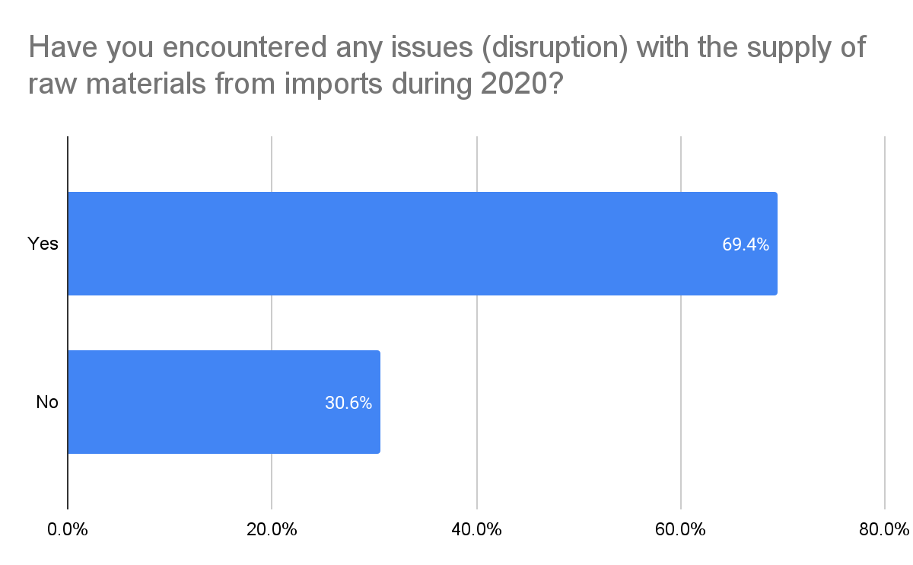
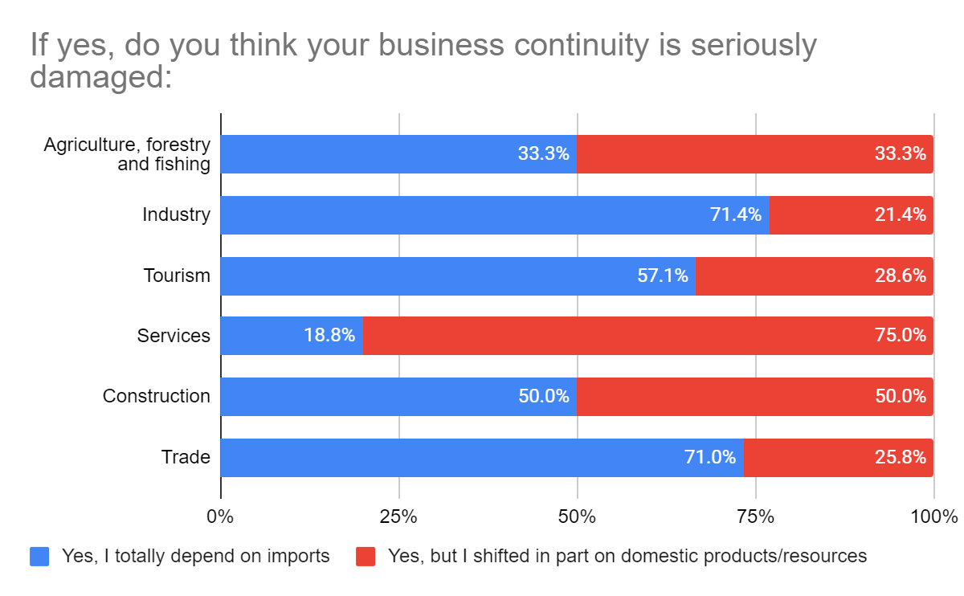
Do you import?
Importers have encountered problems during import which affected the continuity of their activity, mainly in Industry, Trade and Tourism who declare for the most part that they are totally dependent on Imports

Slide 18
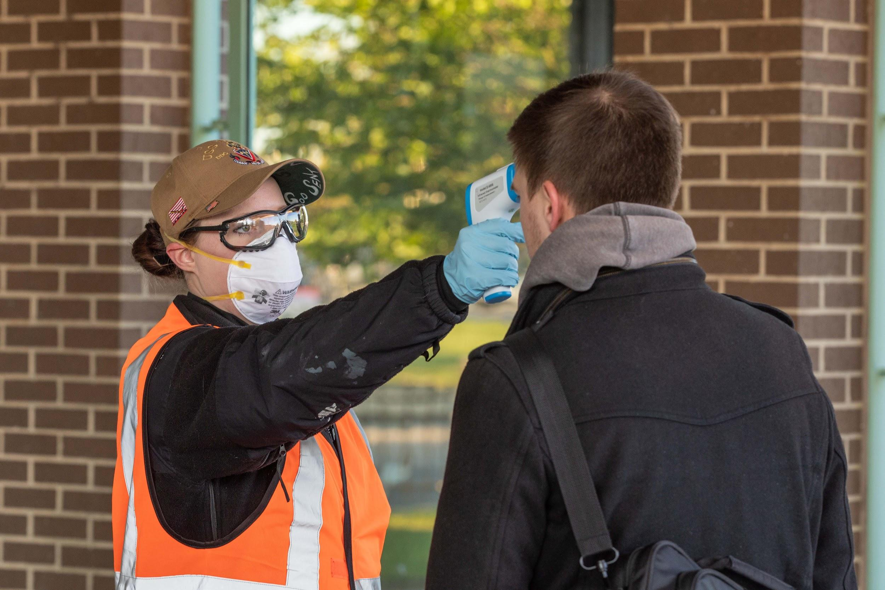
Work Force and COVID-19

Slide 19
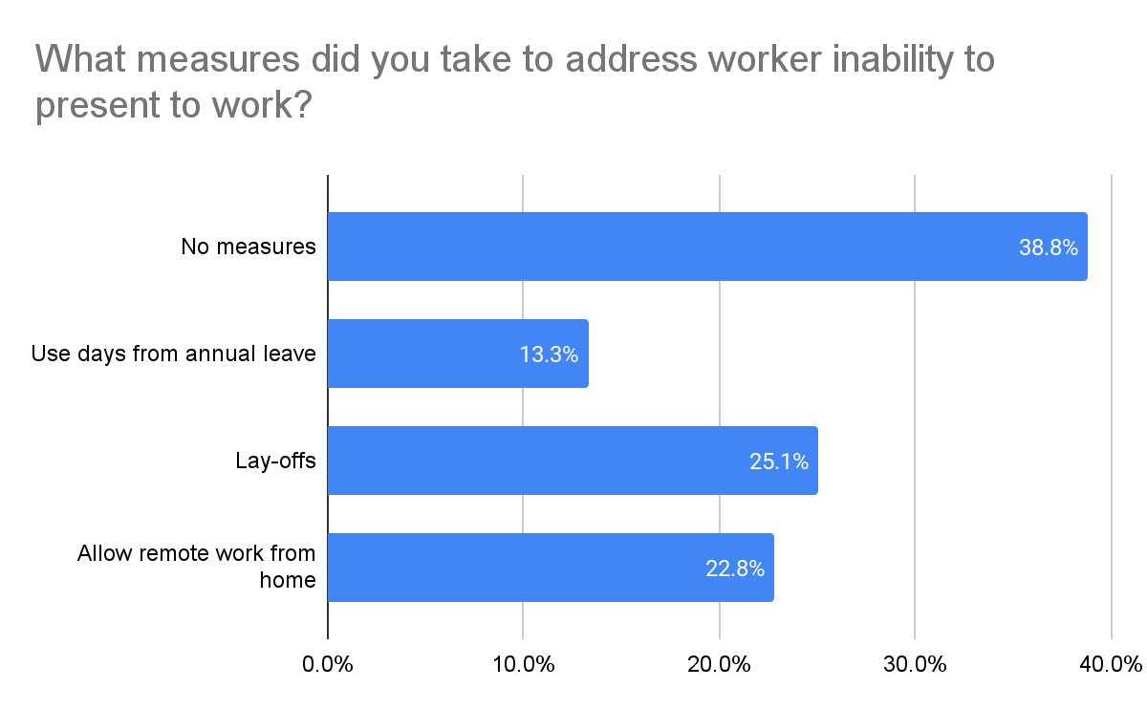
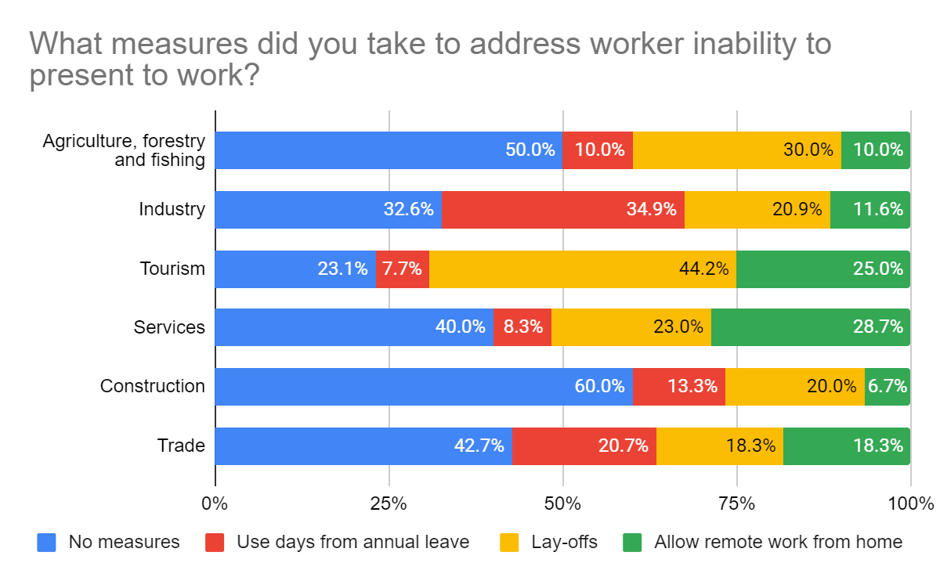
What measures did you take to address worker inability to present to work?
39% of respondents took no measures to address the inability to report for work;
the figures are similar to the responses of respondents a year ago
Tourism has suffered the most from dismissal;
Online work has been largely exploited by the Services sector

Slide 20
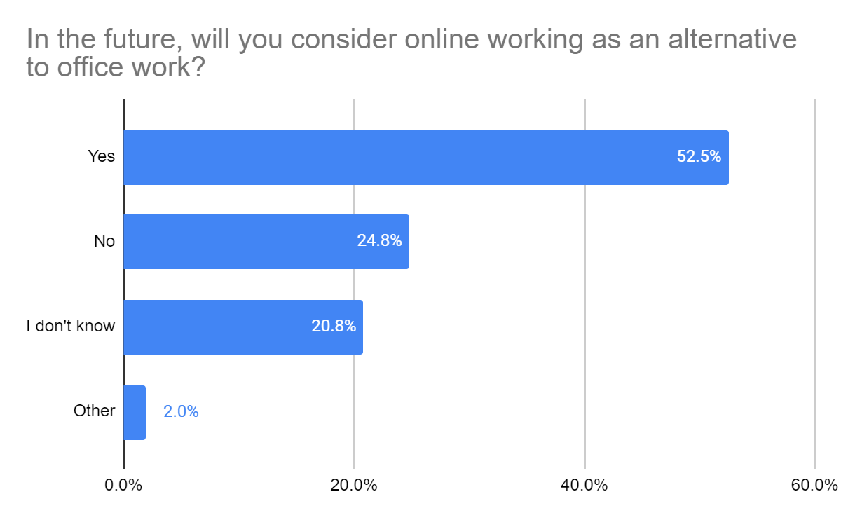
In the future, will you consider online working as an alternative to office work?
Of the 23% of companies that used online work, more than half say they will use this alternative in the future

Slide 21
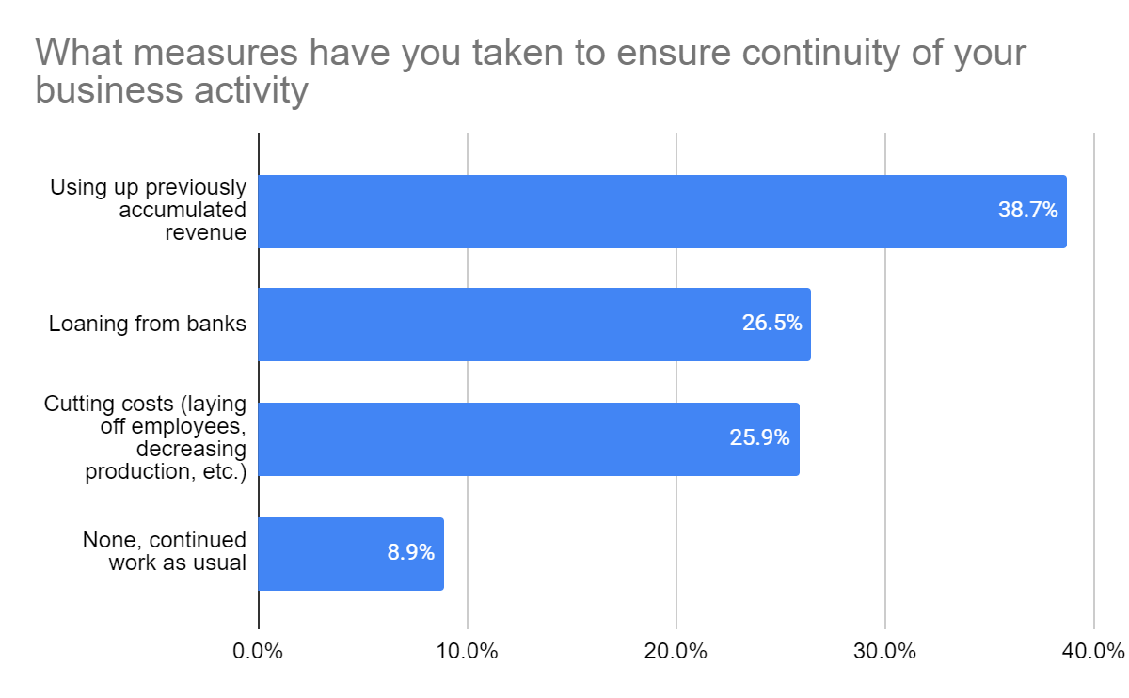
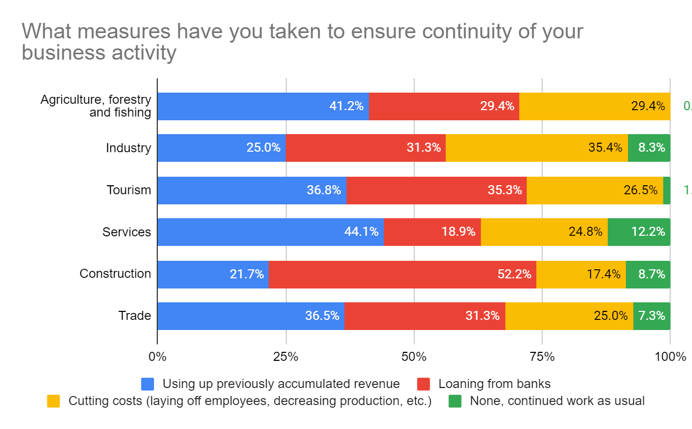
What measure have you taken to ensure continuity of your business activity?
Company savings are again considered as a first measure to ensure continuity;
A year later, bank loaning has moved into second place and cost reduction the third place

Slide 22
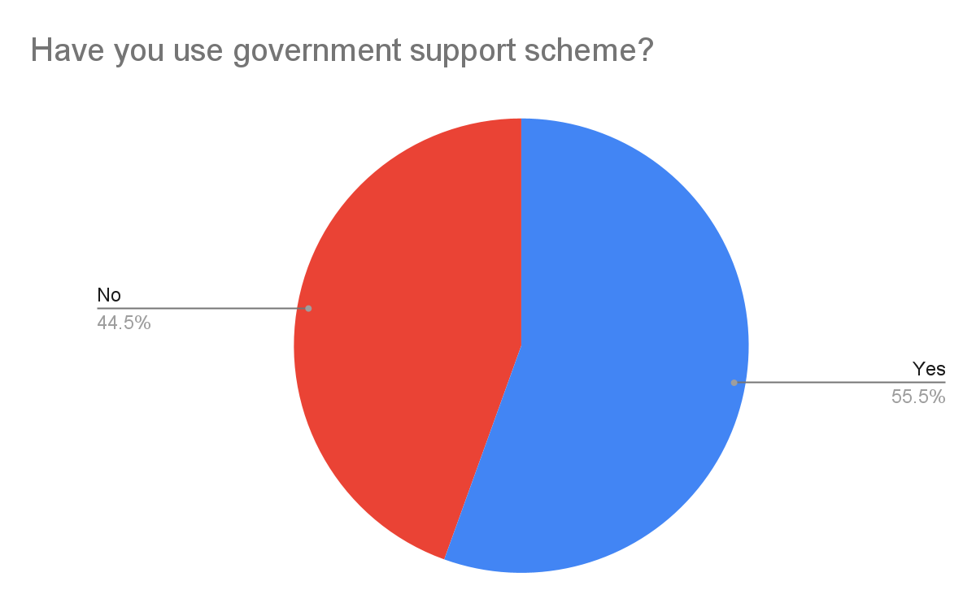
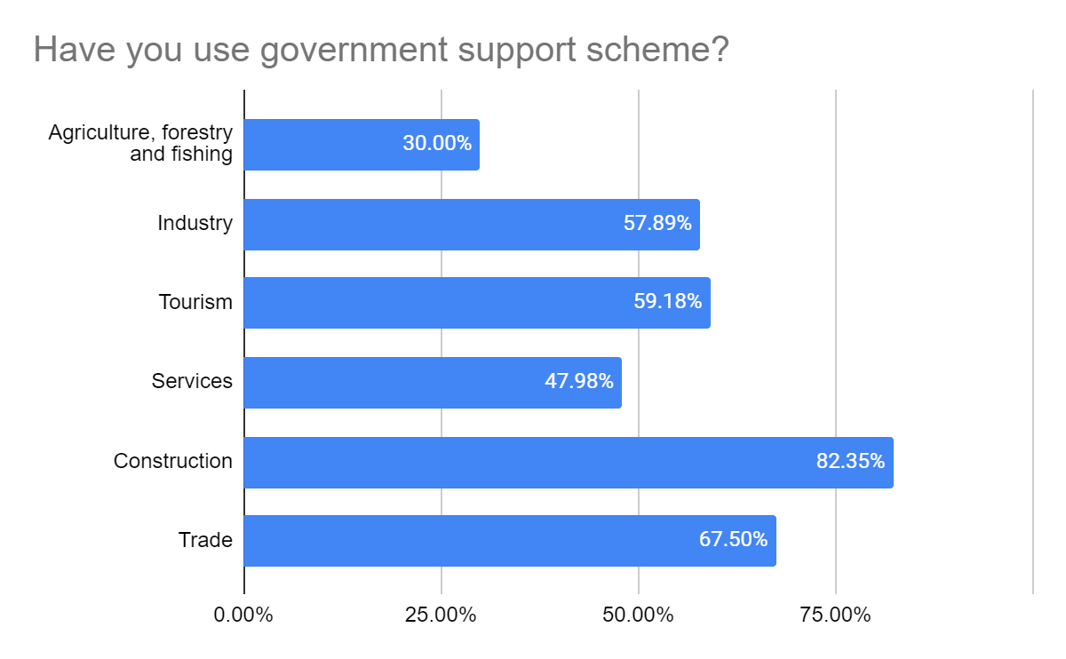
Have you used government support schemes?
55% of respondents state that they have benefited from government support schemes applied after the COVID-19 pandemic;
The sectors that have benefited the most are the Construction, Trade, Industry and Tourism sectors

Slide 23
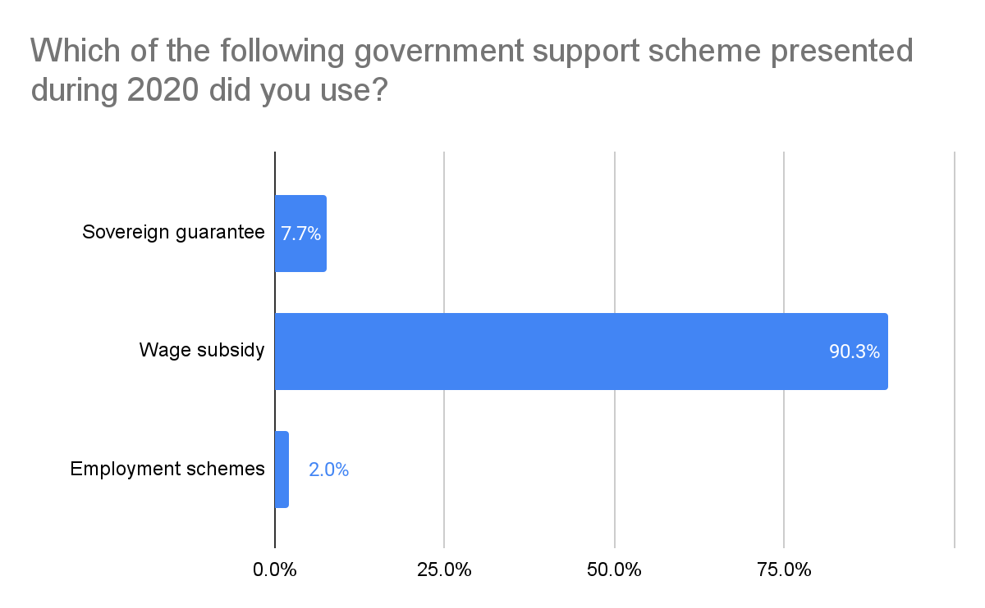
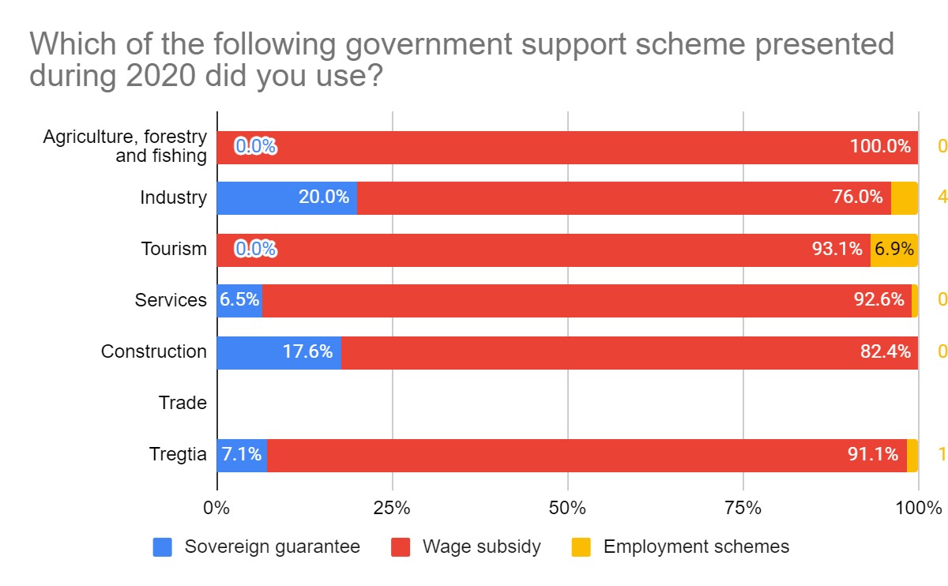
Which government support scheme presented during 2020 did you use?
Wage subsidy has been the most benefited instrument by the surveyed companies, in all sectors of the economy;
Industry and Construction have made the most of the Sovereign Guarantee
Tourism is the sector that has benefited the most from Employment Schemes

Slide 24
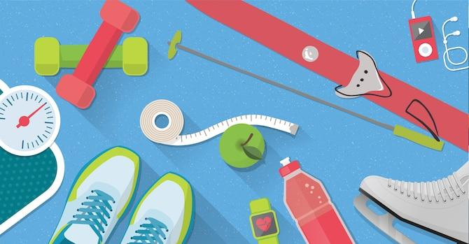
Innovation and COVID-19

Slide 25
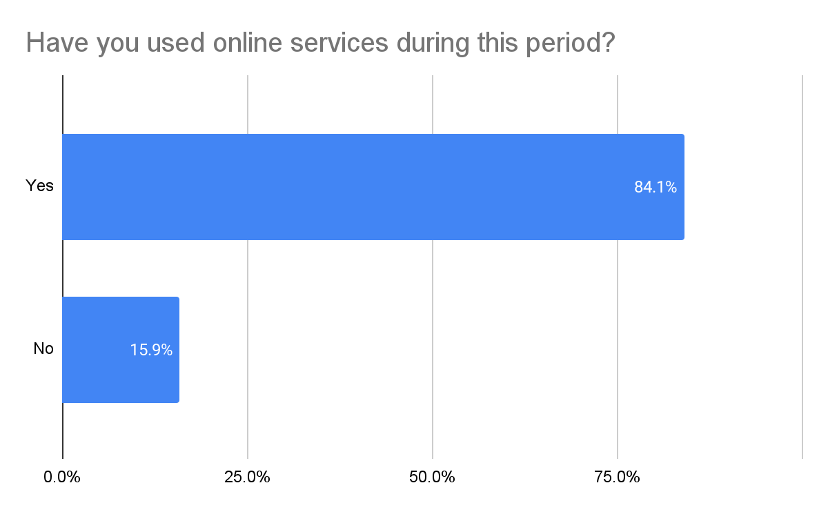
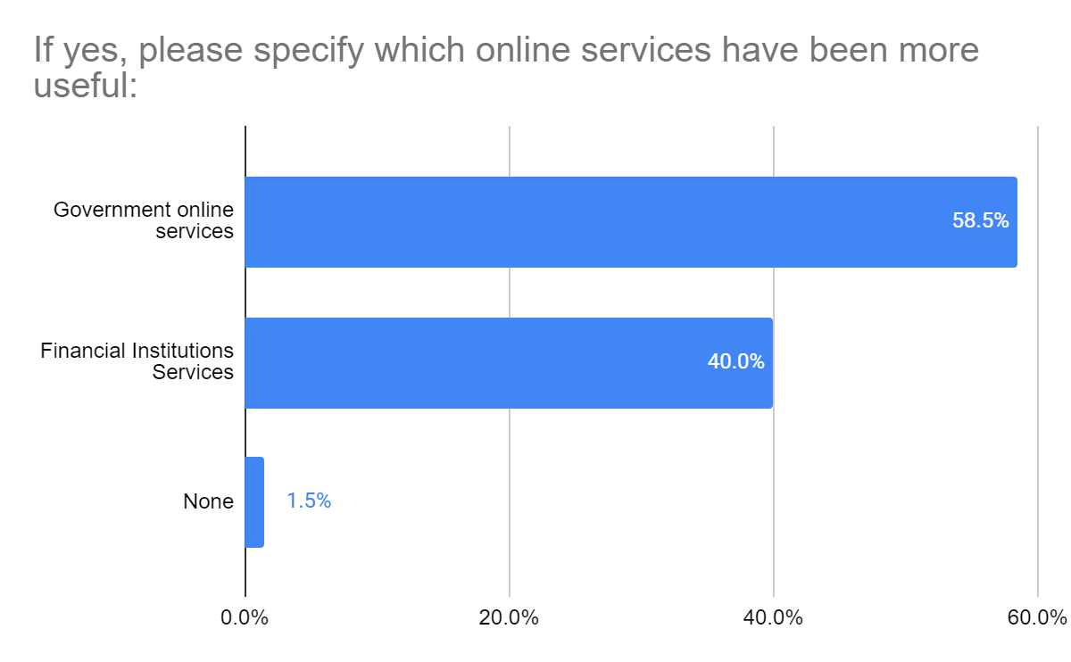
Have you used online services during this period?
Companies have continued to use online services, mainly government services and to a lesser extent the online services of financial institutions

Slide 26
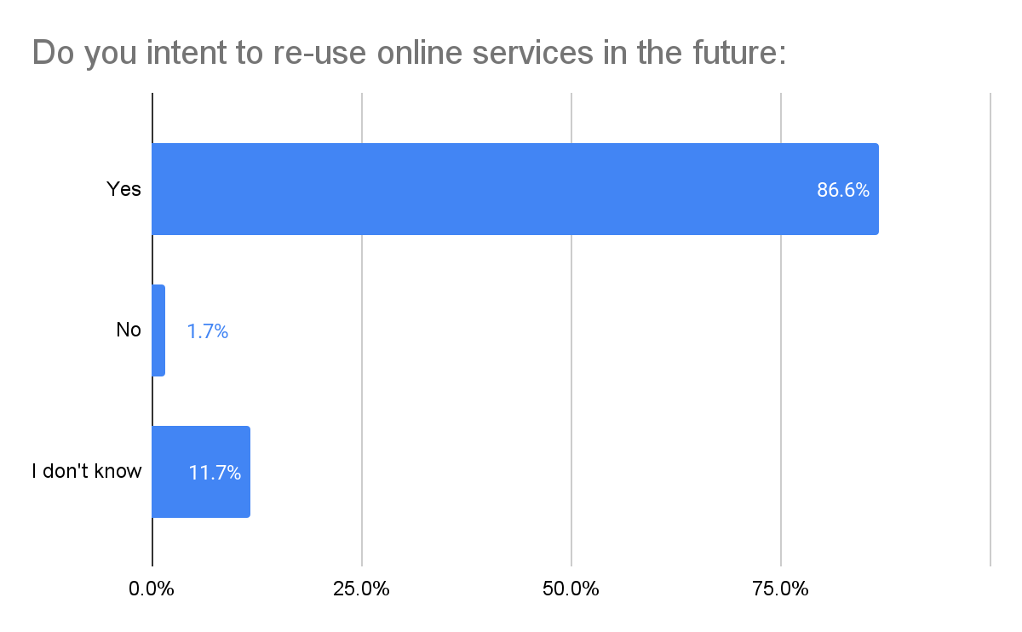
Do you intend to re-use online services in the future?
Companies that have stated that they have used the online services, in 86% of them state that they will continue to use them in the future

Slide 27
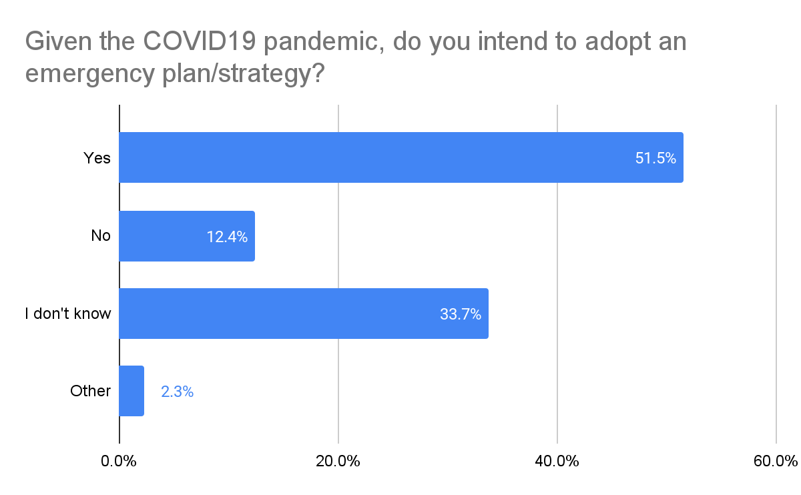
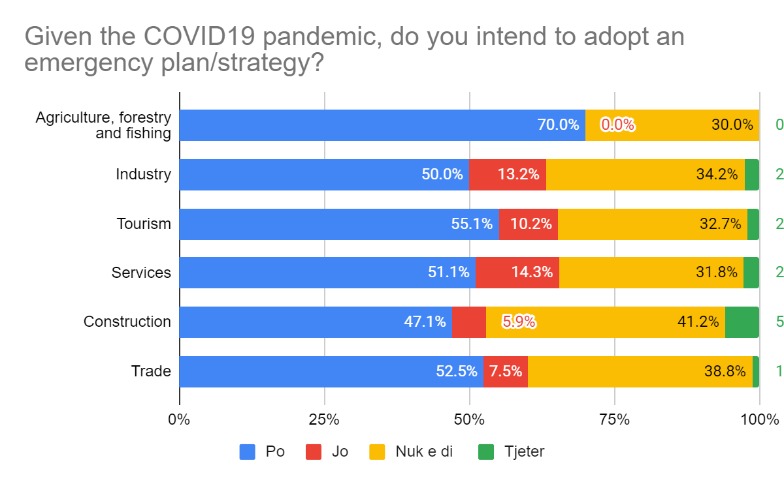
Given the COVID-19 pandemic, do you intend to adopt an emergency plan/strategy?
86% of interviewed companies at the beginning of the pandemic stated that they did not have an emergency strategy
Today, a year later 52% of companies declare that they will adopt an emergency plan, Agriculture, Trade and Tourism are more predisposed.

Slide 28
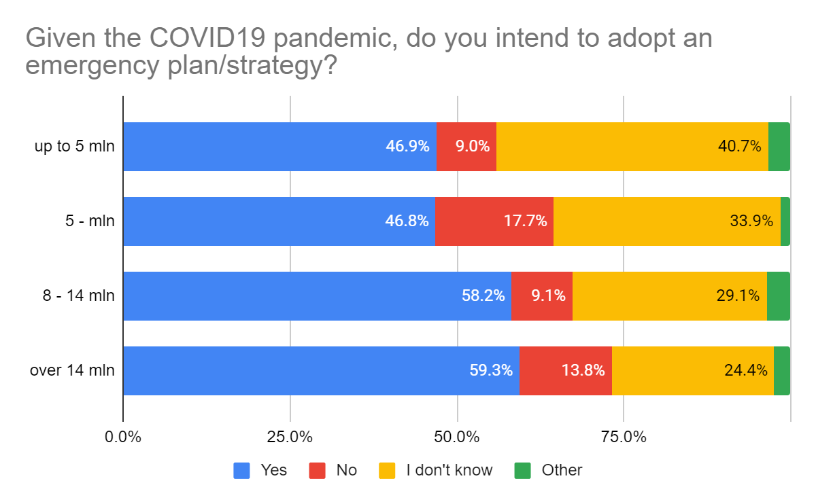
Given the COVID-19 pandemic, do you intend to adopt an emergency plan/strategy?
60% of companies over 14 mln estimate that they will adopt emergency plans, while only 47% of companies up to 5 mln confirm this

Slide 29
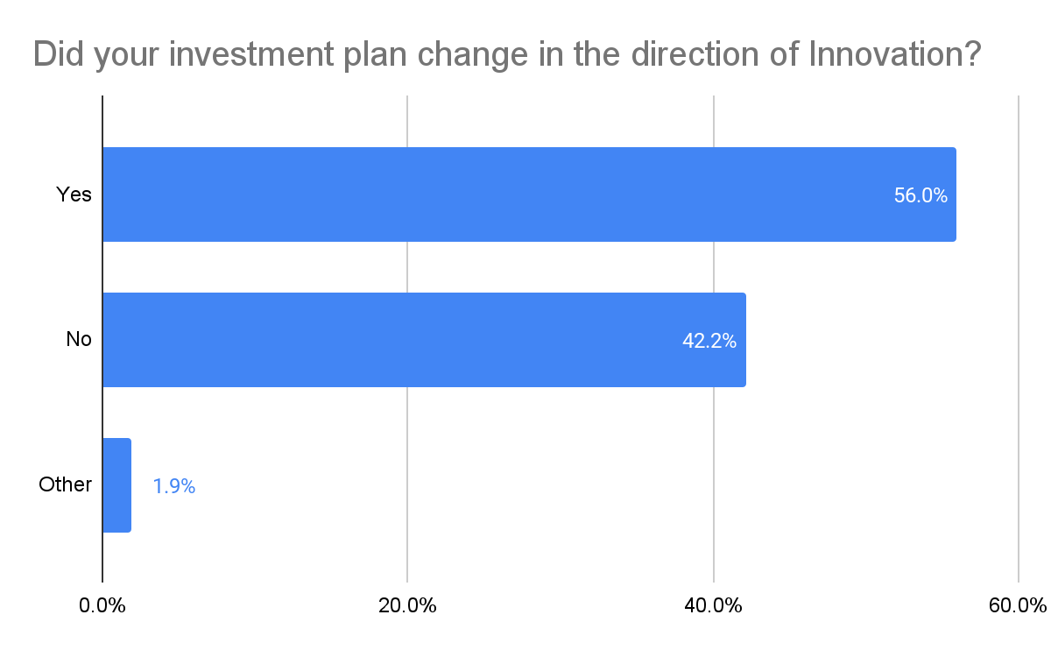
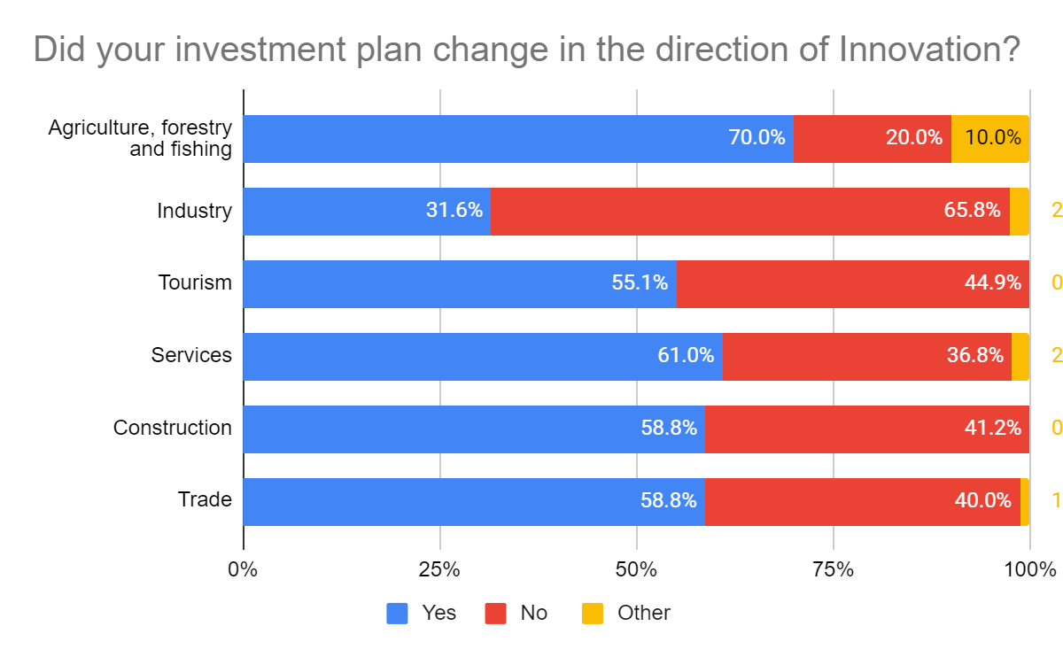
Did your investment plan change in the direction of innovation?
The pandemic seems to have accelerated the need for companies to focus on Innovation, 57% of respondents say they changed their investment plans towards Innovation, mainly new technologies and risk management
Agriculture is the sector with the highest desire to orient towards Innovation

Slide 30
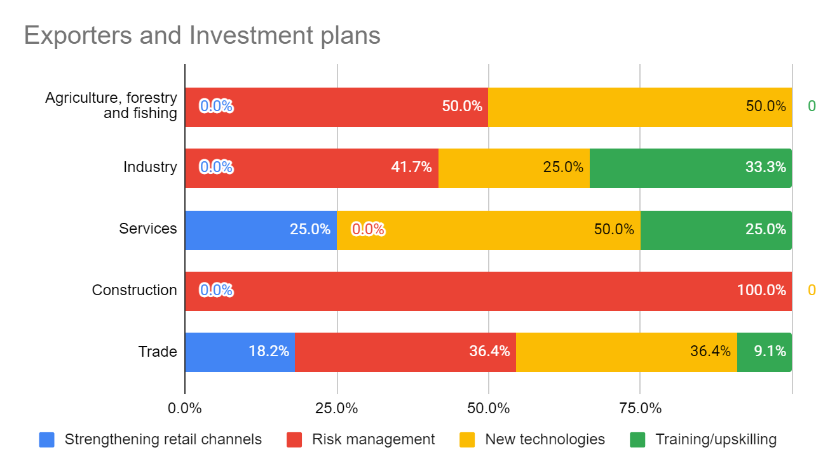
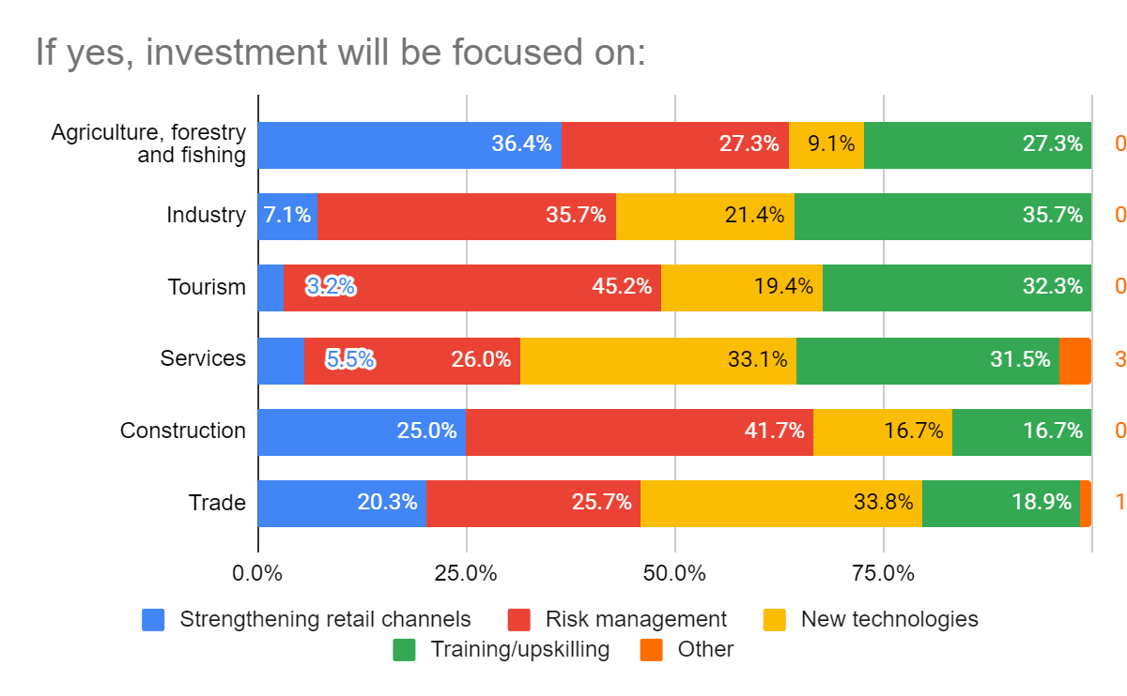
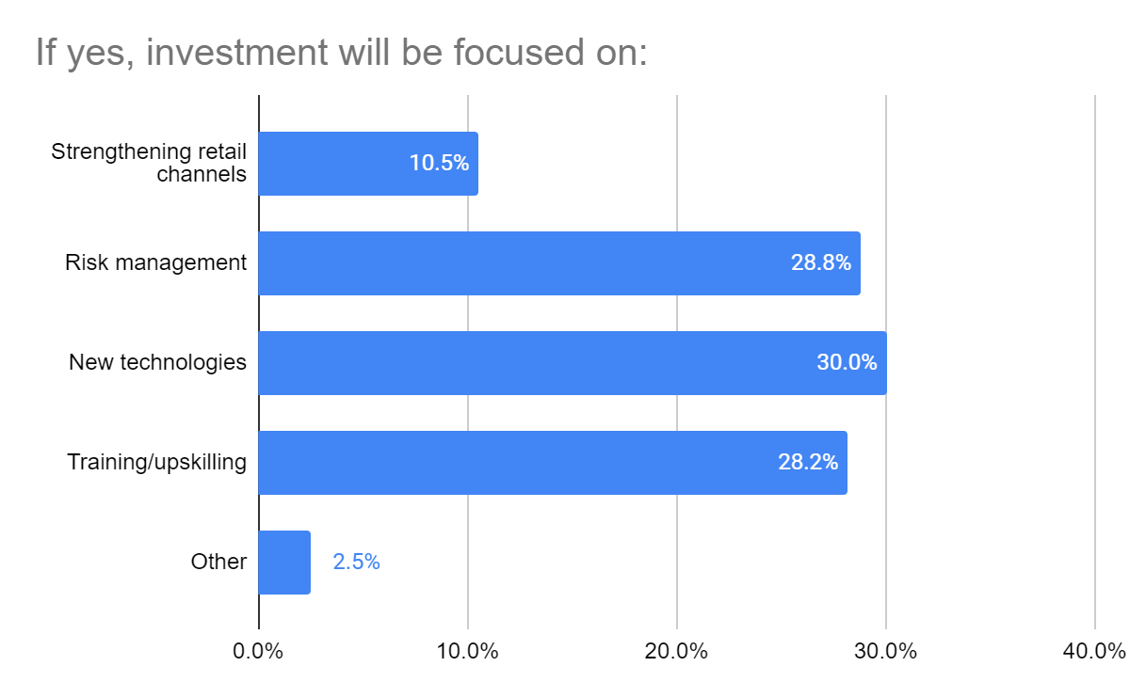
Did your investment plan change in the direction of innovation?
Agriculture will invest more in strengthening trade channels, risk management and new technologies
Tourism in risk management and vocational training

Slide 31
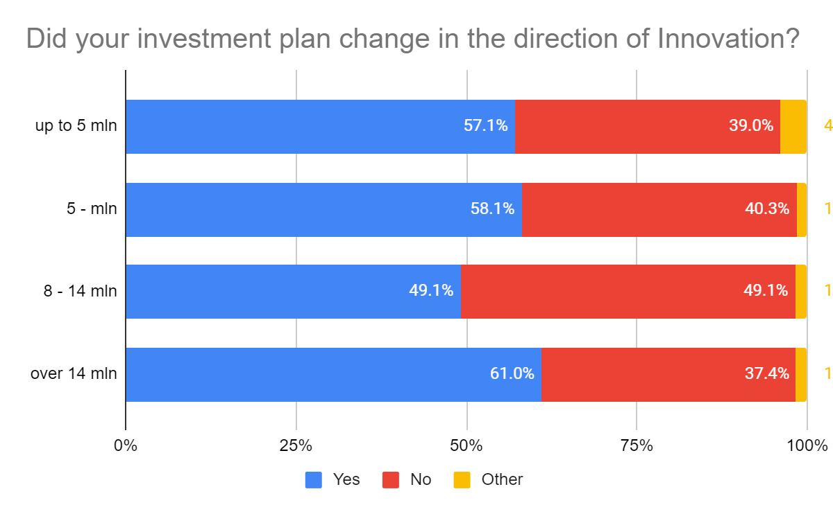

Did your investment plan change in the direction of innovation?
Despite the size, the declaring companies have changed their investment plans towards Innovation, mainly risk management and professional training.

Slide 32

About Investment Council in Albania
The Investment Council facilitates the development of mutual trust between the business community and the government in Albania and contributes to an incremental institutionalization of effective policy dialogue. It contributes to the national reform and economic transition process by enhancing institutions, laws and policies that promote market functioning and efficiency.

